Slide 1
Excel Advanced
Session 8

Slide 2
Contents
Insert Maps
Go to Special (Formulas, precedents, Dependents, Blanks)
Transpose
Convert Function
Filter Function
Timeline by conditional Formatting
Text to Col.
Flash Fill and Quick Analysis

Slide 3
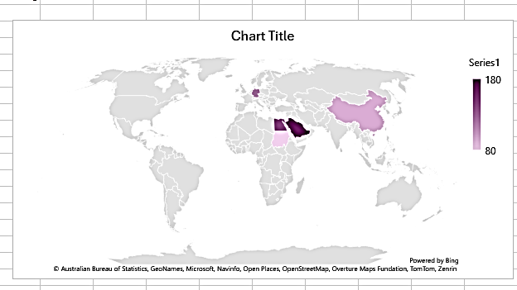
Insert Maps

Slide 4
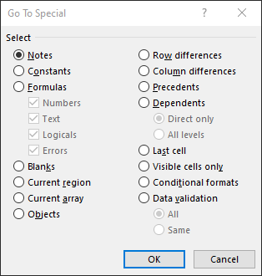
Go To Special

Slide 5
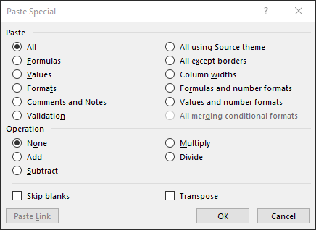
Transpose

Slide 6
Convert Fn.

Slide 7
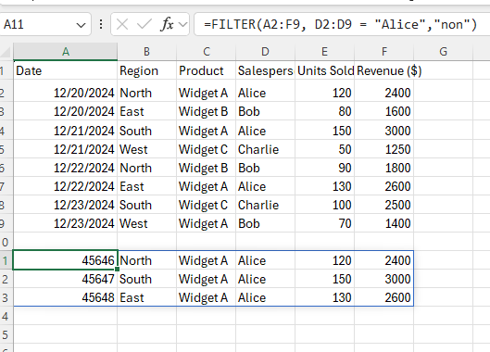
Filter Fn.

Slide 8
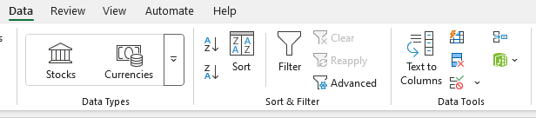
Text to Columns

Slide 9
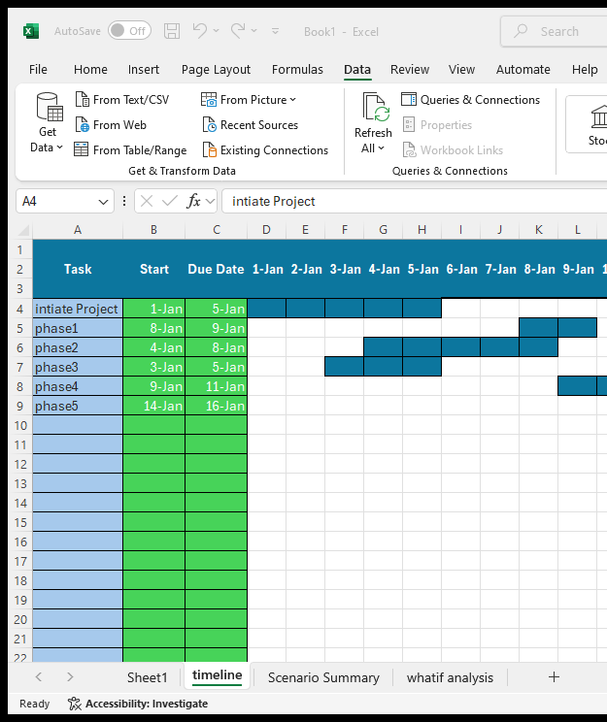
Timeline
Using Conditional Formatting
=AND(D$2<=$C4,D$2>=$B4)

Slide 10
Thank you
Brain Station
Eng. Dalia Khamiss
Session 8

